Slide 1


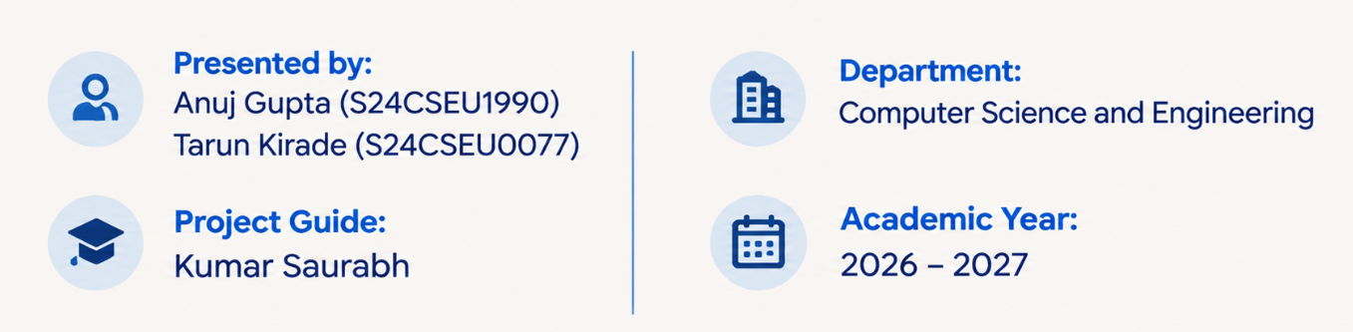
Automated Generation of Cybersecurity Response Playbooks via Large Language Models
AI-Driven Incident Response Automation
Generating, comparing, and validating cybersecurity response playbooks using multiple Large Language Models with Human in the Loop approval.

Slide 2

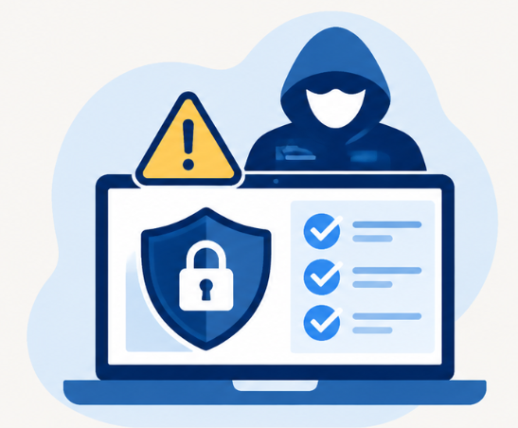

Introduction
As cyberattacks continue to grow in number and complexity, organisations need faster and more effective ways to respond to security incidents.
However, incident response is still largely a manual process. It often takes considerable time and effort from cybersecurity professionals.
Large Language Models (LLMs) offer a way to simplify this process by helping generate structured response playbooks based on specific security incidents.
Our project introduces an AI-based framework that uses multiple LLMs to generate and compare response playbooks, with a human expert reviewing and approving them before execution.

Slide 3


PROBLEM STATEMENT
Cybersecurity incident response still involves a lot of manual work, making the process time-consuming and demanding for security teams.
Traditional response playbooks often follow fixed procedures and may not be suitable for new or changing cyber threats.
Although Large Language Models (LLMs) can generate response suggestions, their outputs may contain inaccurate or incomplete information.
Therefore, there is a need for a framework that can automatically generate and compare incident response playbooks while allowing security experts to review and approve them before execution.

Slide 4


Research Gap
Most existing incident response systems rely on predefined rules and procedures. This makes it difficult to handle incidents that are new or different from expected situations.
LLMs have shown potential in cybersecurity, but generating complete and well-structured incident response playbooks still needs further exploration.
Different LLMs may produce different response suggestions. Comparing their performance can help us understand which models are more suitable for generating response playbooks.
Another important aspect is human involvement. AI-generated playbooks should be checked by security professionals to make sure the suggested actions are appropriate before execution.

Slide 5


Research Objectives
To build a system that can generate cybersecurity incident response playbooks automatically using Large Language Models.
To test and compare different LLMs and understand how well they generate response playbooks for different security incidents.
To include a human approval step where security professionals can review, edit, or reject the playbooks generated by the system.
To develop a practical solution that can reduce manual effort and help security teams handle incidents more efficiently.

Slide 6
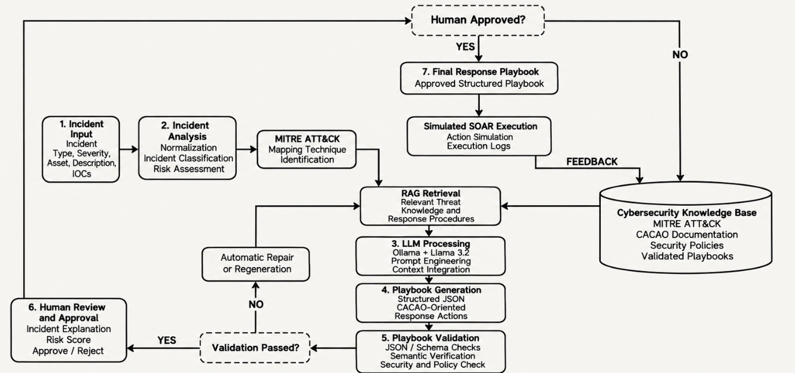
Proposed System Architecture

Slide 7
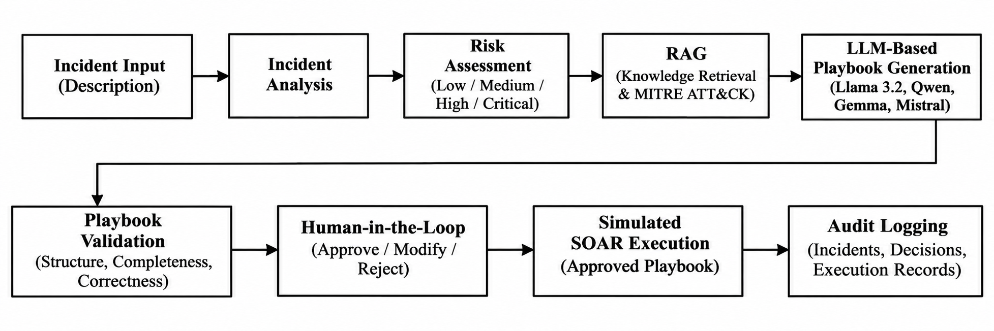
Methodology

Slide 8
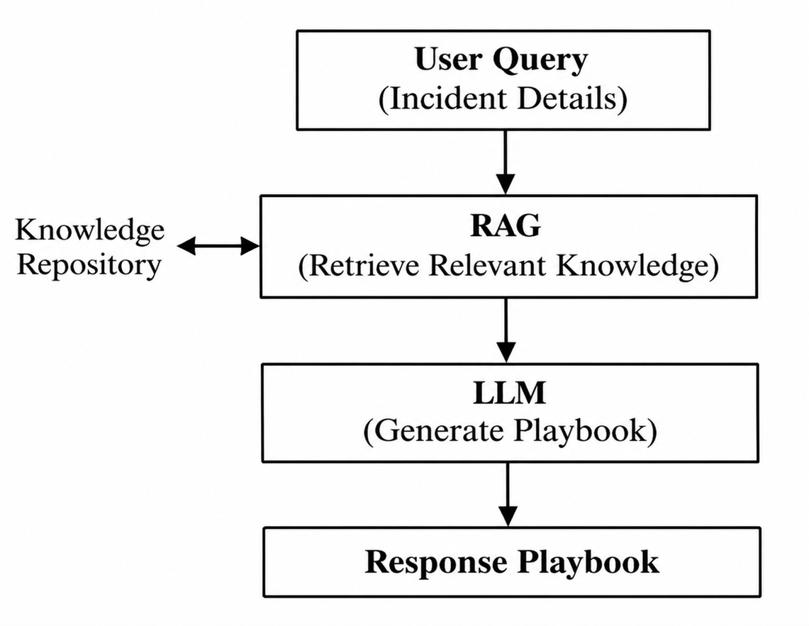
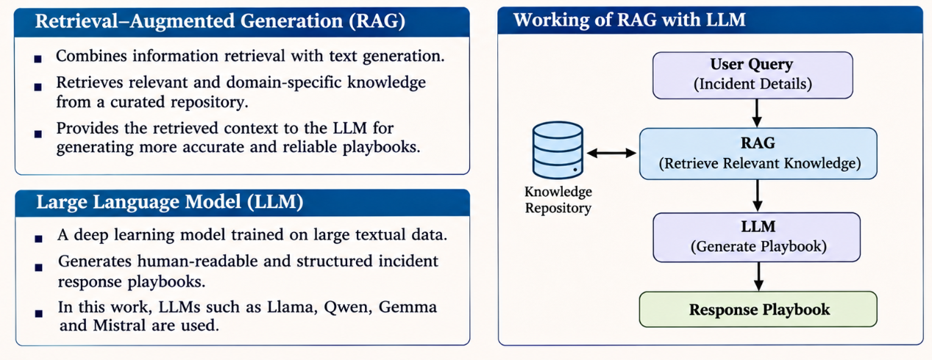
RAG And LLM Implementation

Slide 9
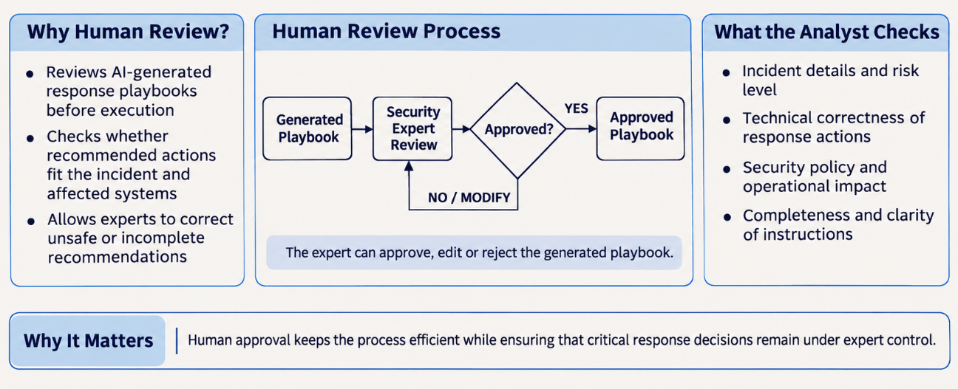
Human in the Loop

Slide 10
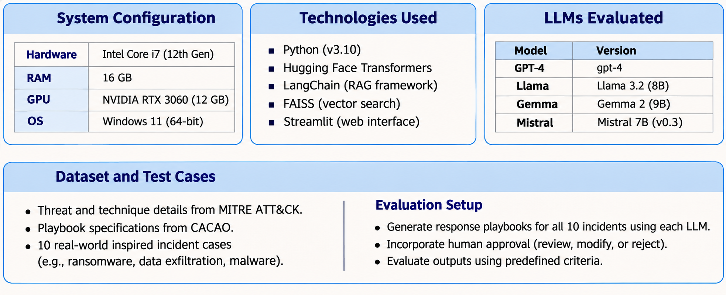
EXPERIMENTAL SETUP

Slide 11
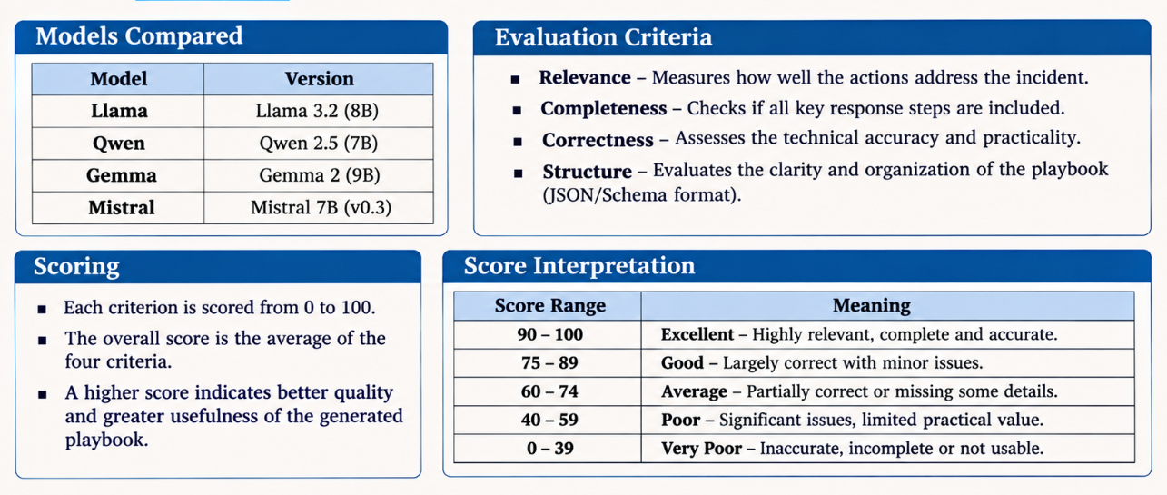
LLM Comparision

Slide 12
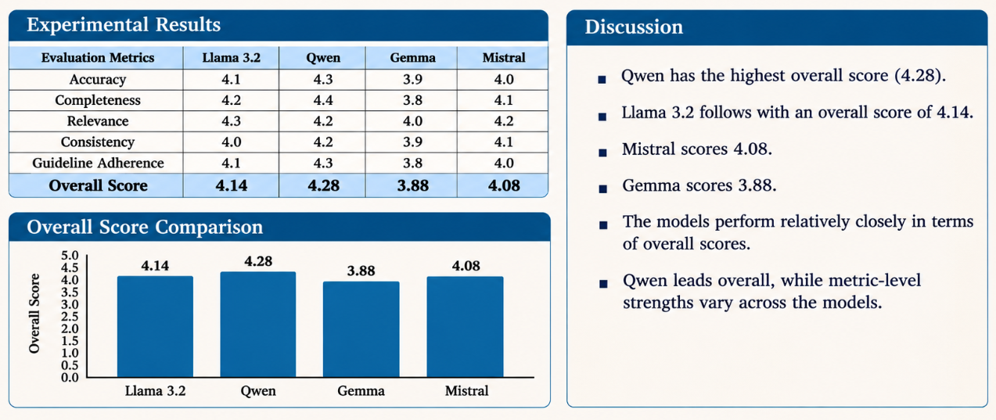
Result and Discussion

Slide 13
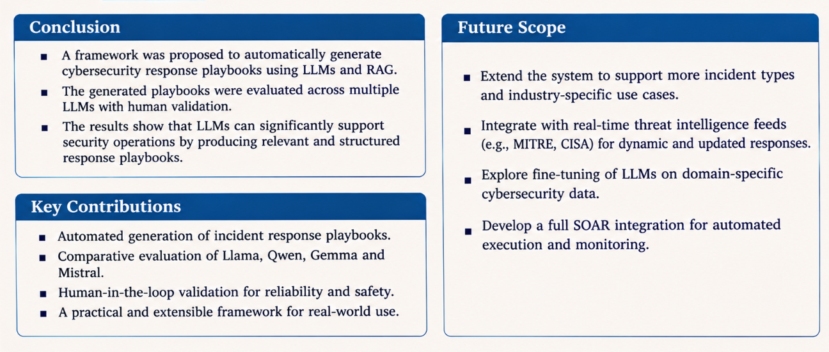
Conclusion and Future Scope

Slide 14
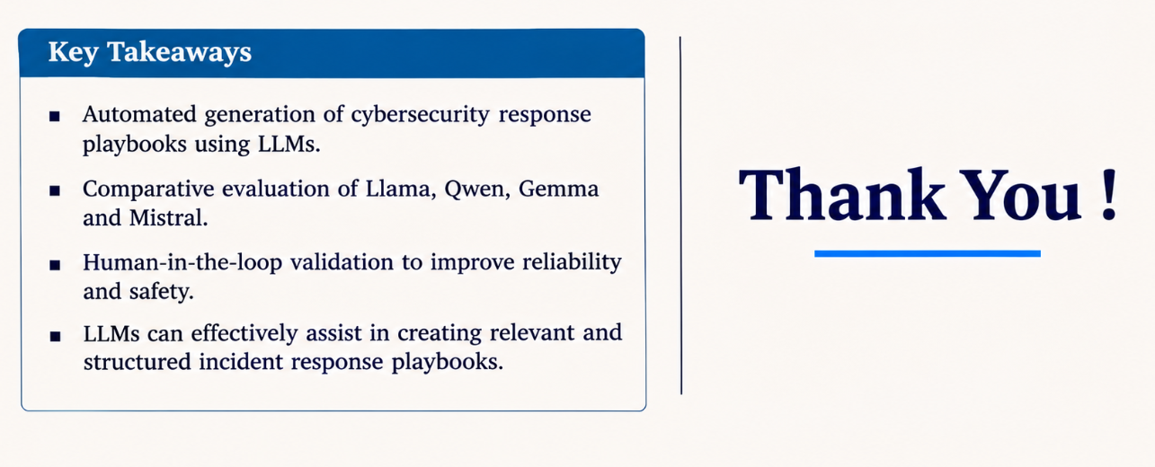
Summary

